Slide 1
Solution-Oriented Requirements
OMSE 531: Week 4
Joe Maybee

Slide 2
Shorthand and Other Timesavers
“Solution-Oriented Requirements” is rather lengthy, so it will appear as SOR in the slides.
Diagrams are tedious to draw, and I don’t have access to the source diagrams from the book, so we will be using live camera shots of some of the diagrams in this lecture.
You will have to keep your own notes on the discussion of the diagrams more closely than you keep your usual notes from the slides (there are no slides for you to annotate.)

Slide 3
What are SORs?
There are Goals …
… and there are Scenarios …
What are SORs and why do we need them?
More ‘detail’ than Goals and Scenarios
Less ambiguity than Goals and Scenarios
Less tolerance for conflict in SOR definition
Specifically, we are moving down the ladder of abstraction with SORs

Slide 4
Three Perspectives
Data: static aspects of data
Functional:
Manipulation of data
Inter-process relationships
Behavioral:
External stimuli
System responses
Often Automata is used

Slide 5
Perspectives are Inter-related
‘Data’ and ‘Functional’ perspectives are useful for deriving the system data, its structure and discipline.
‘Functional’ and ‘Behavioral’ perspectives are useful for identifying the system functions.
Perspectives are not exclusive and may contain other interesting clues, such as relationships found in ‘Data’ and ‘Behavioral’

Slide 6
Goals, Scenarios and SORs
Differences in:
Agreement
Completeness
Conflicts
Level of detail
Intended Solutions
Abstraction decreases with time

Slide 7
Continued Refinement
Progressing toward SORs is an iterative process. Using the progression from goals to SORs aids in:
Elicitation of Requirements
Validation of Goals and Scenarios
Identification of new (or missing) goals and/or Scenarios

Slide 8
Documenting SORs
Basic approaches to documenting SORs are:
Natural Language
Models and Relationships
Graphical Notations
There are several approaches to each of these methods

Slide 9
Natural Language
Natural Language is ambiguous, but still useful
Define Terms
Eschew disjunction (avoid ‘OR’s)
Structure as formality helps:
if <condition> then the system shall:
<action 1>
and <action 2> …

Slide 10
Using Models and Relationships
Modeling perspectives helps form a conceptual notion that is useful. Once again:
“Two important characteristics of maps should be noticed. A map is not the territory it represents, but, if correct, it has a similar structure to the territory, which accounts for its usefulness.”
-- Alfred Korzybski

Slide 11
Using Models
Models for the perspectives:
Data modeling
Functional modeling
Behavioral modeling
Using modeling languages for the specific model helps avoid model problems.

Slide 12
Entity-Relationship Model
Entity is a conceptual construct
Relationships are also conceptual constructs
Defining relationships:
Relationship type
Cardinalities
Generalization or Specializations
Entities and classes: Grouping

Slide 13
Generalizations
Super- and sub-classes:
Sub-classes typically have a higher degree of specialization than super-classes
Super-classes typically have a higher degree of generalization than sub-classes
Usually, it is best to “promote to the highest reasonable level.”

Slide 14
Generalization Relationships
A class (super- or sub-) may consist of more than one entity.
Disjoint vs. overlapping
Disjoint: super-class entities can only belong to one sub-class.
Overlapping: super-class entities may belong to more than one sub-class.
Total vs. Partial
Total: each super-class entity must belong to at least one subclass in total relationships
Partial: a super-class entity may belong to just the superclass.

Slide 15
Class Diagrams
Class concepts:
Class name
Class attributes
Class operations
Example OOP Language constructs:
C++: member functions
Smalltalk: methods
C# attributes, etc.

Slide 16
Attributes
Attributes have:
Type
Multiplicity
Properties

Slide 17
Class Associations
Class Associations:
Multiplicity
Roles
Association class
An “association class” allows for relationships to be dependent on interclass types.

Slide 18
Aggregation and Composition
Difference between aggregation and composition can seem confusing, but:
Aggregation: “composed of some of these parts”
Composition: “composed of all of these parts.”
Diamond notation is drawn where the parts “come together” to form the class

Slide 19
Diagrams and Notations
Generalization
Class Instantiations
Others of note

Slide 20
Perspectives and Specification
Examples of perspective and specification methods:
Functional Specification: Structured Analysis
Behavior Specification: Finite State Automata
Both can be done with other notations.

Slide 21
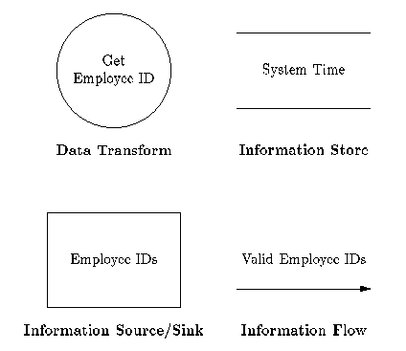
Data Flow Charts

Slide 22
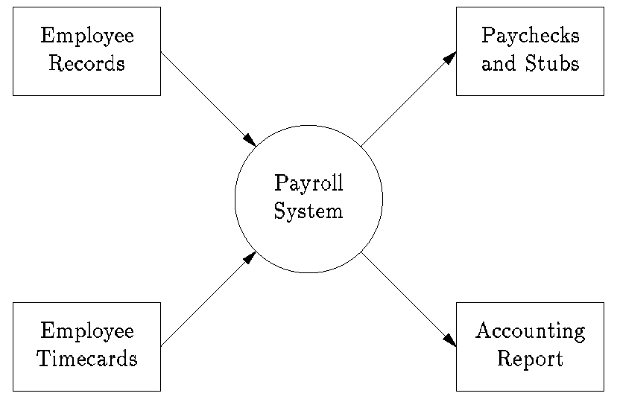
The Level 0 DFD

Slide 23
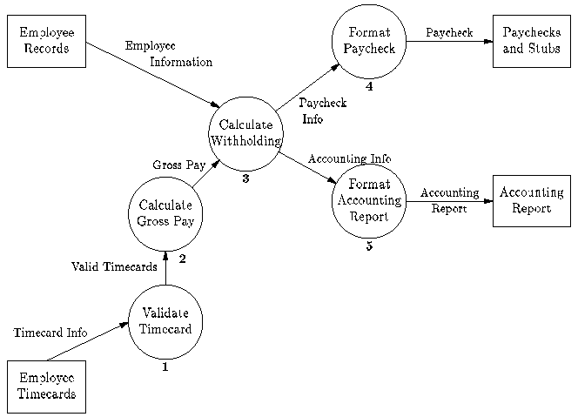
Level 1 DFD

Slide 24
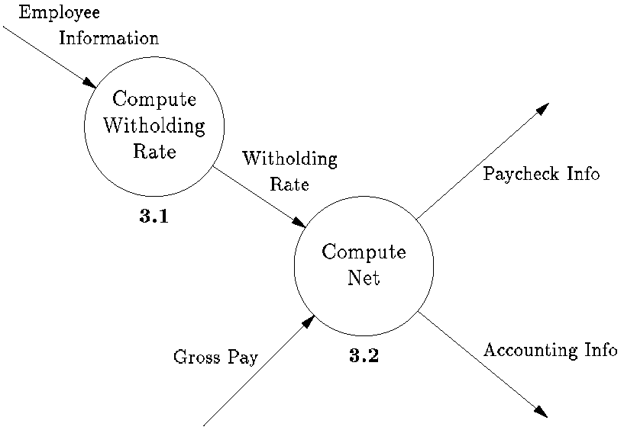
Level 2 DFD

Slide 25
Creating the Data Dictionary
Begin with data flows.
Add descriptive information about content.
Add information about implementation.
Can use programming language notation, because customer is a software implementer.

Slide 26
“Discipline” information in the Data Dictionary
Who “owns” the data.
Who can read the data.
Under what conditions is the data valid?
Dependencies on other data.
Who has the authority to “set” the data?
What conventions must be observed?

Slide 27
Finite State Machines
Derived from Finite State Automata
Focus is flow of control and system responses.
Describes inputs to the system as events, rather than a set of separate inputs
Mathematical techniques, such as state reduction, can be applied.

Slide 28
Finite State Automata Notation
Event/Response
State A
State B
Event/Response

Slide 29
The notion of state persistence
Internal state information is preserved in state variables
State Variables determine state, but in reality, are probably used for information within the program itself.
Object oriented programming is often oriented toward state information.

Slide 30
The idea of deterministic state machines
Given a set of outputs, and inputs, the current state, response, and next state can be determined.
Implications are that for any particular event, there is one and only one response the system can make!

Slide 31
State machines and Reactive Systems
System that can respond to any set of pre-determined events.
There are other advanced notions of finite state automata, dealing with expert systems. However, the most common use is for Reactive systems.

Slide 32
Reactive Systems
Contemporary examples of these include:
Windows programs
Macintosh programs
X Windowing System programs
Microwave ovens
Video Recorders

Slide 33
Specification of Reactive Systems
There are similar ramifications as specifications of batch systems.
You must be able to determine how the system will respond (outputs).
Provable completeness of requirements specifications is less of a problem, due to the definition of events. (Input reduction)

Slide 34
Specification of Reactive Systems (continued)
Provable incompleteness comes from the idea that system response for a given event in a particular state is unspecified.
Important work has been done in this area, ask for references if you are interested.

Slide 35
Event-loop Programming
Typically, programs written for reactive environments use “event-loop” programming.
An “event recognizer” interprets input changes and organizes them into a set of events.
Events are dispatched to relevant processes.

Slide 36
Event-loop Programming (continued)
Processes are responsible for maintaining internal state information and responding to the event.
Processes typically can also synthesize and dispatch their own events.

Slide 37
Event-loop Programming (continued)
done = FALSE;
while (!done) do
Event = GetNextEvent();
switch (Event) {
case BEEP: ring_bell();
break;
case QUIT: done = TRUE;
}

Slide 38
Statecharts
Also ‘Machine charts’ a slightly different approach.
Combining approaches.
Example

